Slide 1
Deconfliction &
Separation Management
Air Traffic Separation and
Collision Avoidance

Slide 2
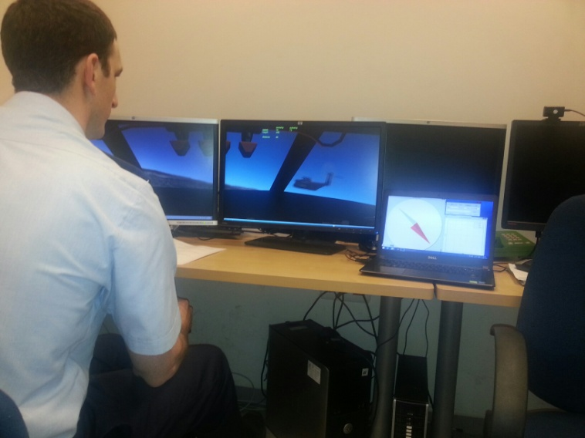
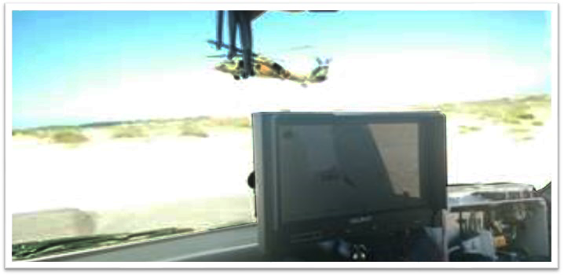
Safe separation for the UTM
Ciconia deals with Deconfliction & Safe Separation
for “low & slow” since 2011 with the C&CAS:
“Control & Collision Avoidance System”

Slide 3
Safe separation for the UTM -
New standards & terminology required:
Examples:
‘Street roof’ altitude
Max speed between buildings: horizontal, vertical
Maximum density of air traffic in a given volume
Minimum DbP (Distance between Platforms)
Minimum TtC (Time to Collision) between platforms
Speed control

Slide 4
New standards & terminology required:
‘Street Roof’ Altitude:
Only vertical speed below street roof?
Stop before climbing over street roof?
Roof top?
90m
Roof top?
30m
Setting ‘street roof’:

Slide 5
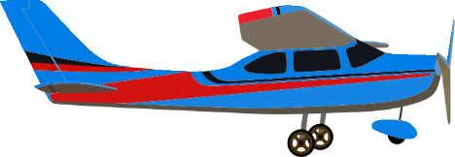
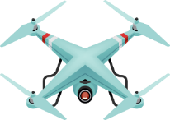
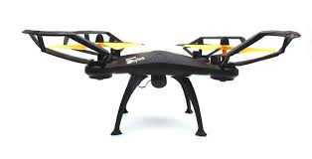
New standards & terminology required:
‘Density limit’
- Maximum platforms in a given air volume:
Set by regulator
Enforced by:
Strategic level while allocating air space to users
C&CAS – decentralized density control
Too crowded!
(Min. range limit maintained)

Slide 6
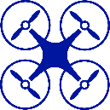
New standards & terminology required:
Separation between platforms:
Minimum DbP (Distance between Platforms)
Drone 2
area of operation
Min distance
450m
Drone 1
area of operation
Minimum TtC (Time to Collision) between platforms
Drone 1
max speed = 15m/s
TtC = 15sec.
Drone 2
max speed = 15m/s
450m
(15m/s + 15m/s)
= 15sec.

Slide 7
Test case 1:
5 drones operating in 5 areas
Min DbP (Distance between Platforms) > 450m
Min TtC (time to Collision) >= 15 sec.
2
1
Unused air space!!!
5
Min DbP
450m
4
3

Slide 8
5 drones operating in 5 areas
Min DbP (Distance between Platforms) > 120m
Min TtC (time to Collision) >= 15 sec.
Test case 2:
2
1
Smaller unused air space
but
TtC (Time to Collision) = 4sec.!
20m/(15m/s+ 15m/s)= 4sec
5
120m
4
3
To maintain TtC>= 15sec.,
Drones 2 & 4 must slow to 4m/sec [120m/(4m/s+4m/s)=15sec]

Slide 9
5 drones operating in 5 areas
Min DbP (Distance between Platforms) > 120m
Min TtC (time to Collision) >= 15 sec.
Test case 2:
5
2
1
120m
450m,
Slow
Minimum unused air space
And
TtC limit (15 sec.) is kept
4
3
Who will slow the drones in real time?
C&CAS – decentralized density control

Slide 10
Safe separation for the UTM –
new standards & terminology required:
Ciconia decentralized C&CAS:
Monitors constantly at the vehicle level:
DbP (Distance between Platforms)
TtC (Time to Collision)
RoC (Rate of Closure)
Traffic density
Informs operators of potential separation violation
Displays steering commands to pilots; onboard & remote
Takes control over autopilot to avoid separation violation

Slide 11
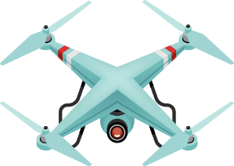
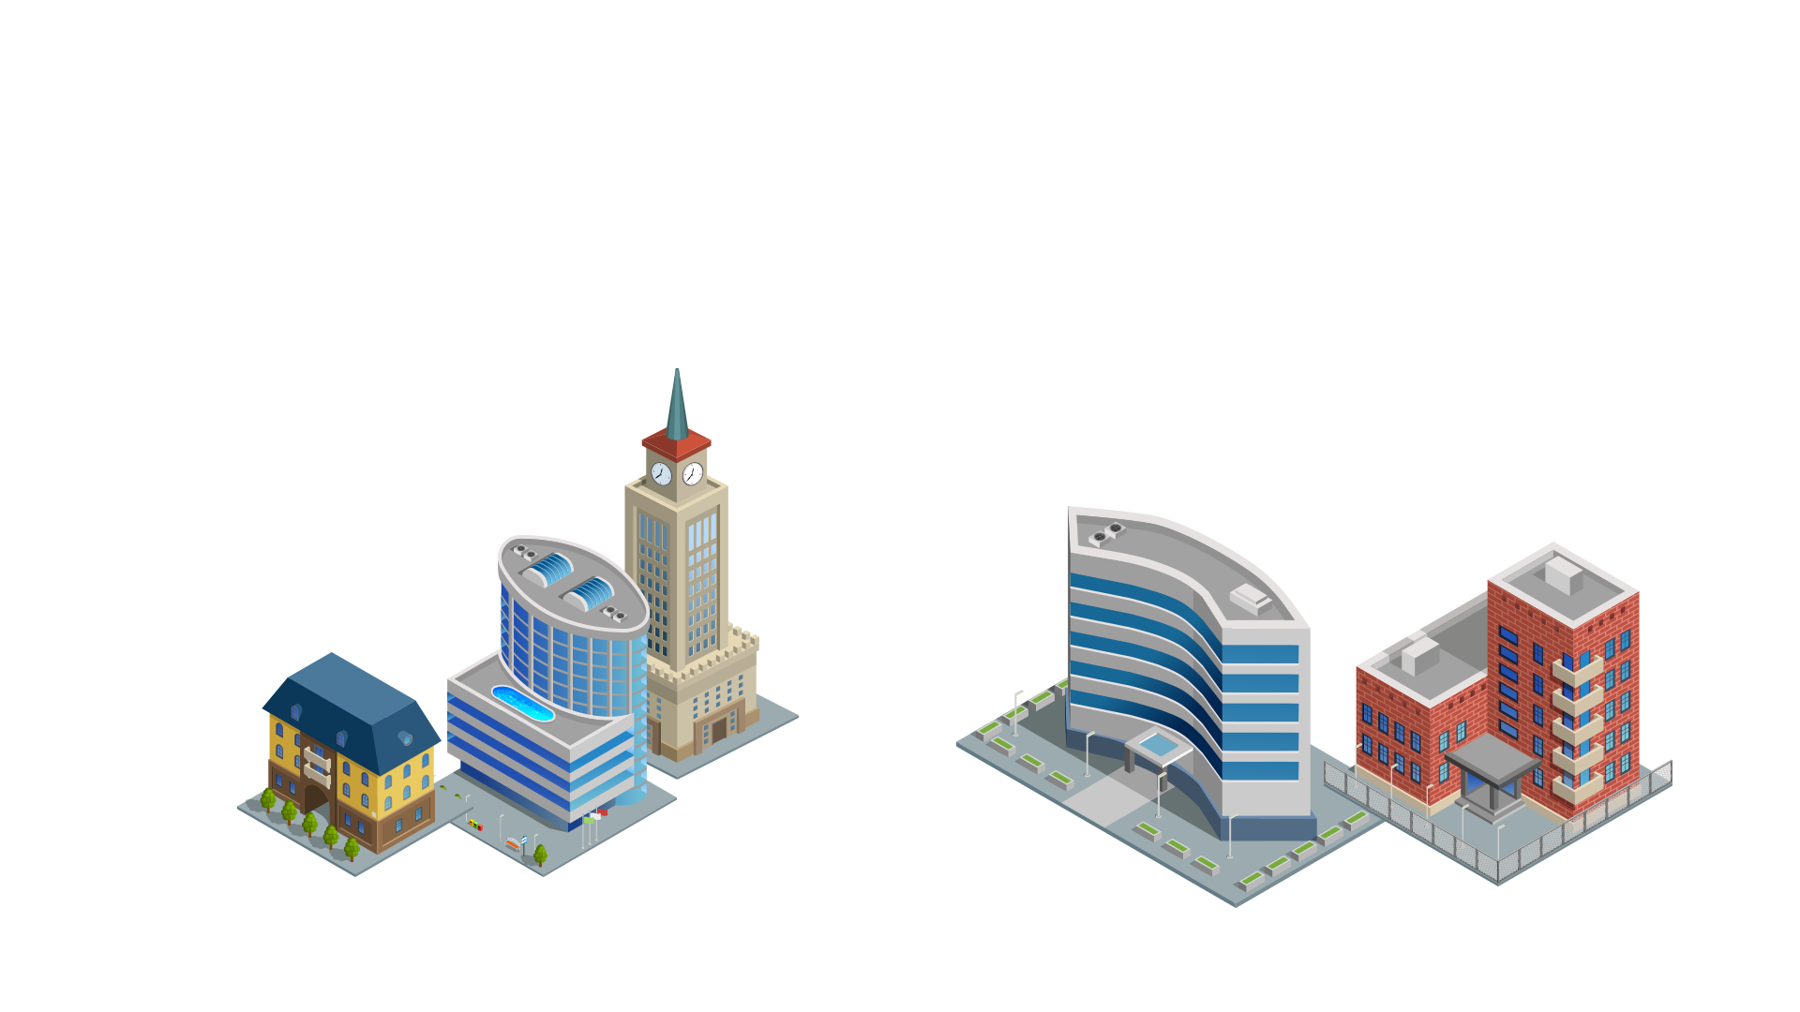
Enforcement of separation limits
Ciconia’s decentralized C&CAS (Control & Collision Avoidance)
A V2V network (remote ID?)
ADS-B In data
ADS B out
ADS B out
Drone’s C&CAS unit
ADS B out
Coordinates
Coordinates
ADS B out
Helicopter C&CAS unit
Drone’s C&CAS unit
Coordinates
C&CAS introduces:
C&CAS Flight Cues
Remote pilot C&CAS unit
Flight cues to human pilots
Steering commands to autopilots

Slide 12
Conclusion
New terminology & limits required (‘street roof’, ‘traffic density’, etc.)
As sophisticated as the ATM may be, there will be midair traffic conflicts!
Decentralized monitoring & enforcement is the only way to ensure safety of flight and efficient use of airspace

Slide 13
Conclusion (Cont.)
Ciconia’s C&CAS has been proven in flight tests
Decentralized C&CAS will allow more traffic while keeping highest
safety standards
Thank you!

